Slide 1
Silverlight and SharePoint
Jake Adams
Thompson Coburn LLP

Slide 2








Session Evaluations
Schedule and evaluate each session you attend via our mobile app that can be used across devices at http://spsaturday.cloudapp.net
You will be able to evaluate a session 25 minutes before the scheduled end time
Evaluations are stored anonymously and your feedback is appreciated
The app will be the only method available to submit session evaluations for the event and we hope you find it intuitive and convenient

Slide 3
Overview
Silverlight background
Pro and cons of using Silverlight with SharePoint
Getting Started with Silverlight web parts inside of SharePoint
How to interact with SharePoint data using Silverlight
More advanced examples and demos

Slide 4
About Me
Jake Adams
Thompson Coburn LLP
email: jacobladams@gmail.com
twitter: @jacobladams
geekswithblogs.com/jacobladams
github.com/jacobladams
speakerrate.com/jacobladams

Slide 5
Silverlight
Originally codenamed WPF/Everywhere
V1 released in 2007
Currently on version 5
Cross-browser, cross-platform application framework
Originally intended for building RIAs (Rich-internet applications)

Slide 6


Silverlight + SharePoint = ?

Slide 7
Silverlight + SharePoint == Goodness
Runs on the client
Reduces server resources
More responsive / Better UX
Reduces post backs

Slide 8

Silverlight + SharePoint == Goodness
Graphically-rich development stack
(draws pretty pictures)
Vector graphics
Control templating
Intelligent layout system
3D Engine

Slide 9
Silverlight + SharePoint == Goodness
Powerful data binding capabilities
Model-View-View Model pattern

Slide 10
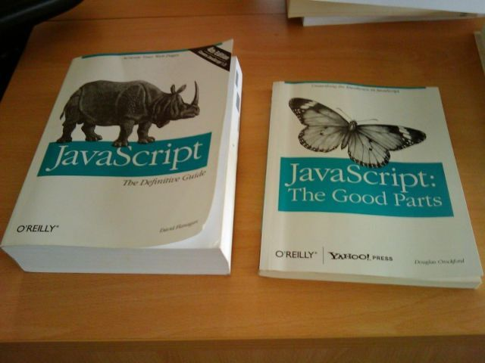
Silverlight + SharePoint == Goodness
Runs on .NET

Slide 11
Silverlight + SharePoint == Goodness
Can be developed outside of SharePoint
Doesn’t require SharePoint to be installed.
Makes testing easier
Easier deployment
Can be deployed outside of SharePoint

Slide 12
Silverlight + SharePoint != Goodness
Plugin required
75% of all browsers have Silverlight installed
0% of mobile browsers have Silverlight

Slide 13
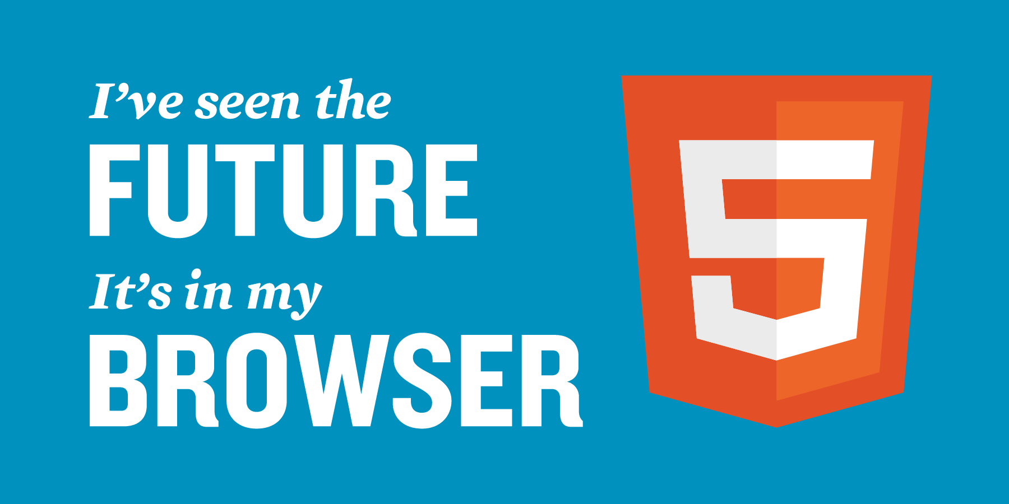
Silverlight + SharePoint != Goodness
Future of Silverlight is uncertain
Microsoft may be shifting focus towards HTML5

Slide 14
Demos

Slide 15


Getting Started
Compile Silverlight application into XAP file
Put XAP file somewhere that SharePoint can access it.
I prefer using a separate document library.
Add Silverlight web part to a page.
Reference XAP file in web part.
4a) Pass in configuration parameters if necessary.
Sip Piña coladas on the beach.

Slide 16
Accessing SharePoint From Silverlight
Client Object Model
SharePoint Web Services
OData API
Silverlight/JavaScript Bridge
Custom Web Services

Slide 17
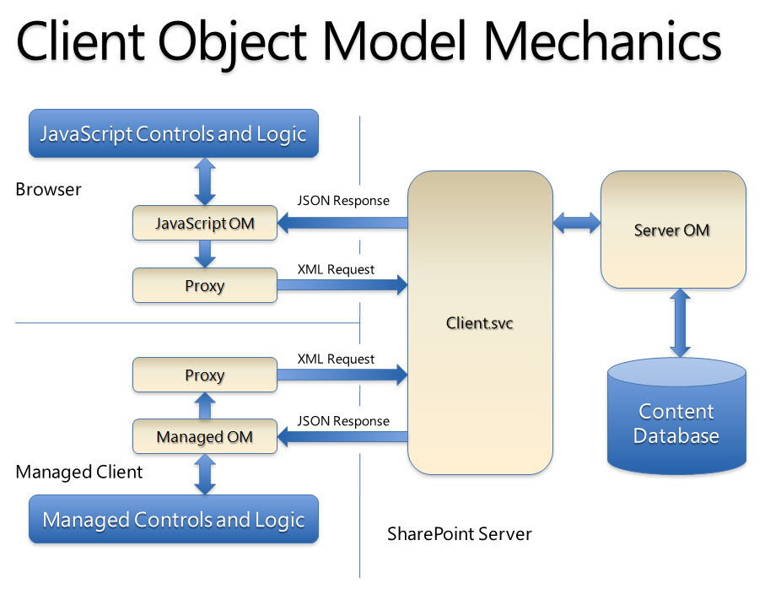
Silverlight Client Object Model

Slide 18
Links
SP 2010 Client Object Model - bit.ly/L0S1Jl
Silverlight 5 Trusted Applications - bit.ly/JP9BoE
Great Silverlight Examples –
bit.ly/L0S4VF
bit.ly/JweBZp
bit.ly/KZuiYz
SharePoint Online Development - bit.ly/L5wjb9
Bundle of all the links - bit.ly/JTrmP8

Slide 19
Housekeeping
Follow SharePoint Saturday St. Louis on Twitter @spsstlouis and hashtag #spsstl
Play “Sponsor Bingo” to register for your chance to win one of the many great giveaways at the end of the day
Schedule and evaluate each session you attend via our mobile app that can be used across devices at http://spsaturday.cloudapp.net

Slide 20
Recap
email: jacobladams@gmail.com
twitter: @jacobladams
github.com/jacobladams/presentations/tree/master/silverlight-and-sharepoint
speakerrate.com/talks/11321-silverlight-and-sharepoint

Slide 21
Housekeeping
Follow SharePoint Saturday St. Louis on Twitter @spsstlouis and hashtag #spsstl
Play “Sponsor Bingo” to register for your chance to win one of the many great giveaways at the end of the day
Schedule and evaluate each session you attend via our mobile app that can be used across devices at http://spsaturday.cloudapp.net

Slide 22




Slide 23












Thanks to Our Sponsors!
Gold
Silver
Raffle

